Slide 1
Sedimentary Rocks

Slide 2
By the end of this lesson, you should be able to:
Identify the three types of sedimentary rocks
Explain how clastic, organic and crystalline rocks are formed.

Slide 3
Clastic sedimentary rocks are the most common type of sedimentary rock.
Clastic sedimentary rocks are made up of pre-existing sediment.

Slide 4
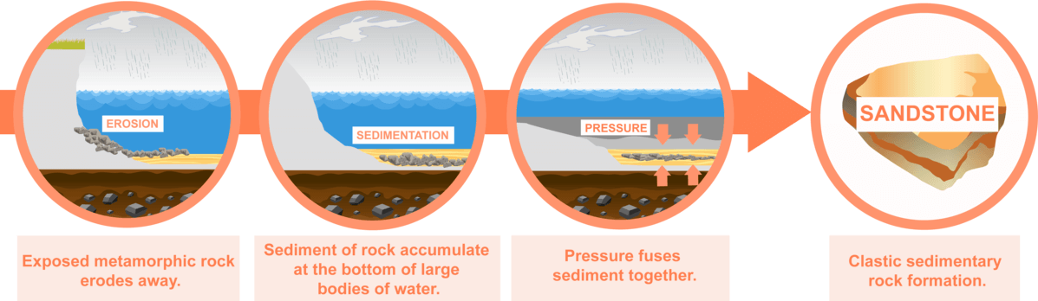
When sediment is carried into the ocean, they form horizontal layers on the seafloor.
The sediment can build up over thousands or even millions of years!
Over geological time, the piling sediment applies pressure to the sediment below it in the pile.
This pressure squeezes water out of the sediment and compacts them to make hard layers.

Slide 5
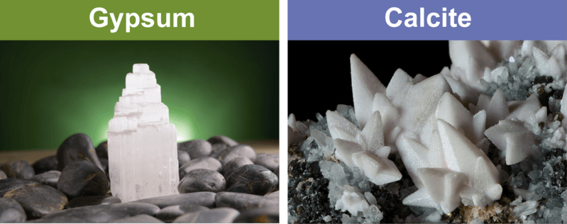
As water is squeezed out of the sediment, new compounds can seep into them and stick the sediment particles together.
These compounds that stick together sediment grains are called cements. Not surprisingly, this process is called cementing.

Slide 6
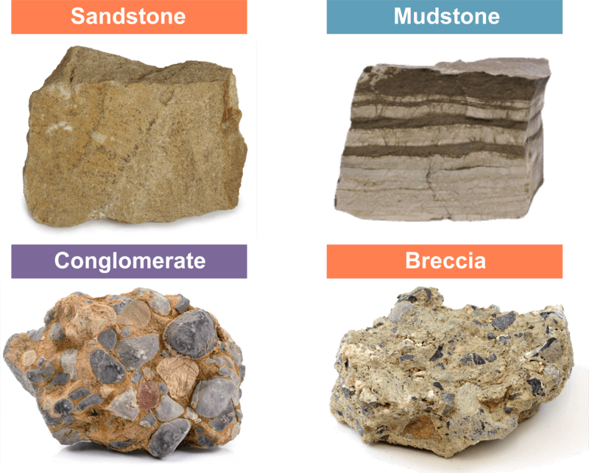
Eventually, the original sediment turn into clastic sedimentary rocks.
After being compacted and cemented over huge stretches of time, they become hard rocks!
Common clastic sedimentary rocks include sandstone, mudstone, conglomerate and breccia.

Slide 7
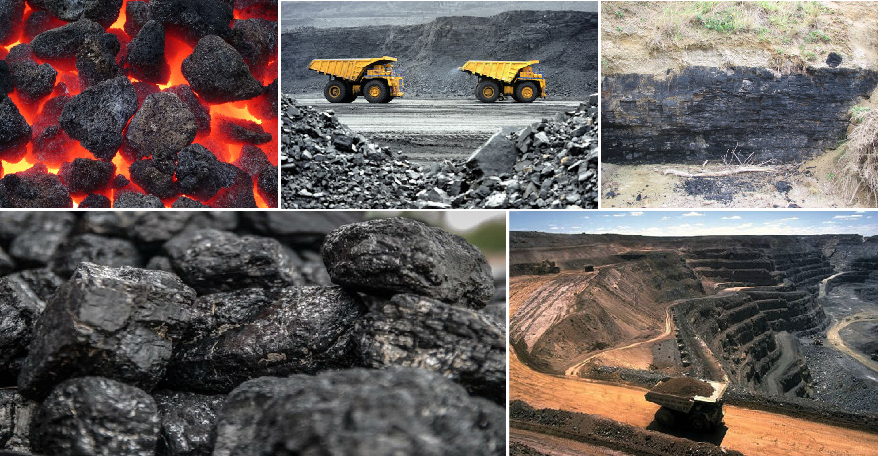
Organic sedimentary rocks are made from dead organic material that is compacted and cemented.
The term 'organic' refers to something that is living or was once living.
For example, coal is made up of the remains of dead plants that lived in swamps and bogs.

Slide 8
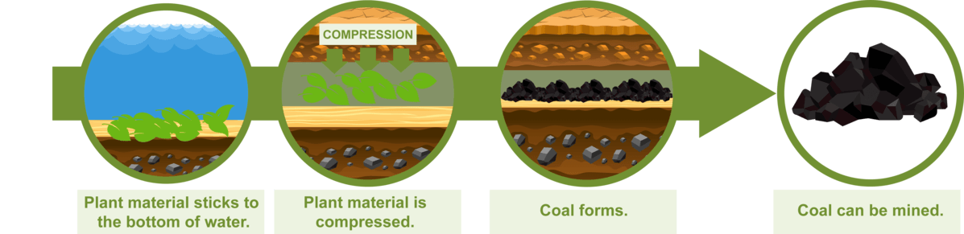
The diagram below shows how coal forms from rotting plant matter.
The different colours represent different layers of sediment, including sand and mud, that settle on top of the plant matter over time.
This process is very slow; much of the coal burned on Earth today was formed 300 million years ago, before the dinosaurs existed!

Slide 9
Some kinds of limestone are also organic sedimentary rocks.
Limestone is any sedimentary rock that contains more than calcite.
In organic limestone, that calcite comes from the broken shells of dead sea creatures (i.e. fossils), such as molluscs, crustaceans and even plankton!

Slide 10
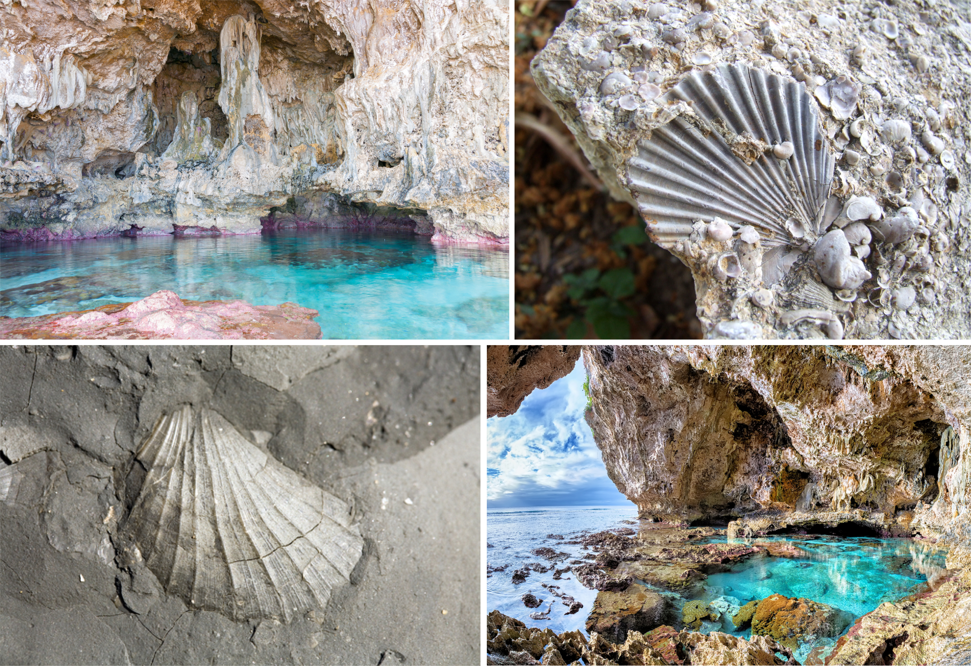

Slide 11
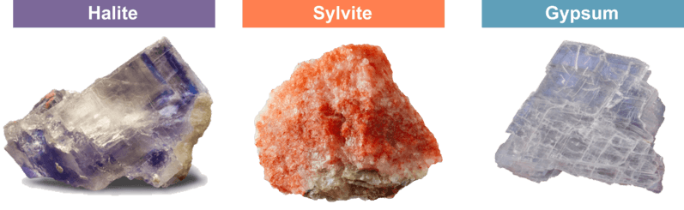
Crystalline sedimentary rocks are not made of eroded sediment, nor organic matter.
They are composed of salt minerals that collect in dry, hot areas such as coastal deserts.
Such minerals include halite (rock salt), sylvite (potash) and gypsum.

Slide 12
Repeated rain, then evaporation, causes many layers of salts to build up on top of each other.
Over hundreds, thousands or millions of years, the layers are compacted by their own weight and form crystalline sedimentary rocks.
This is happening right now on the shores of the Dead Sea in Israel, where these gypsum domes form.

Slide 13
